Slide 1
Practical project
Roman Emperors Web Application

Slide 2
New skills learned
Spring Boot
JavaScript
HTML/CSS
Selenium
IntelliJ
Visual Studio Code
Postman

Slide 3
Intro
The concept of the app
Methodology/Workflow
CI Pipeline
Demo
Review - areas to improve
Questions

Slide 4
Article Sharing Web-App For Roman Emperors
Studied Ancient History at uni
Users can share articles by historians about Roman emperors
Could not find any websites dedicated specifically to this
Useful for the casual historian or history students

Slide 5
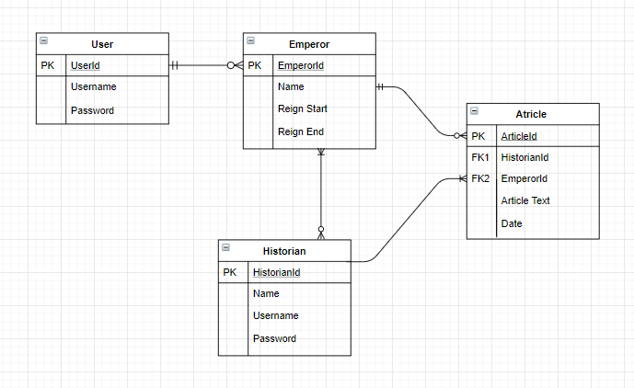
ERD

Slide 6
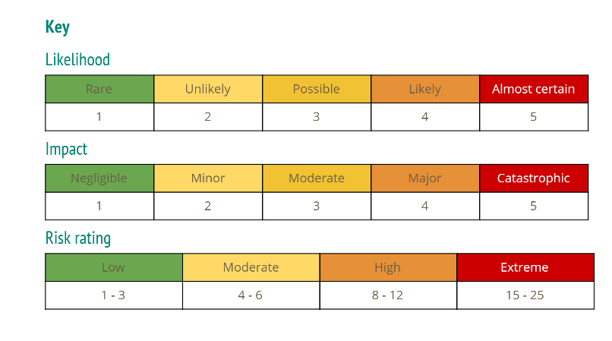
Risk Assessment

Slide 7
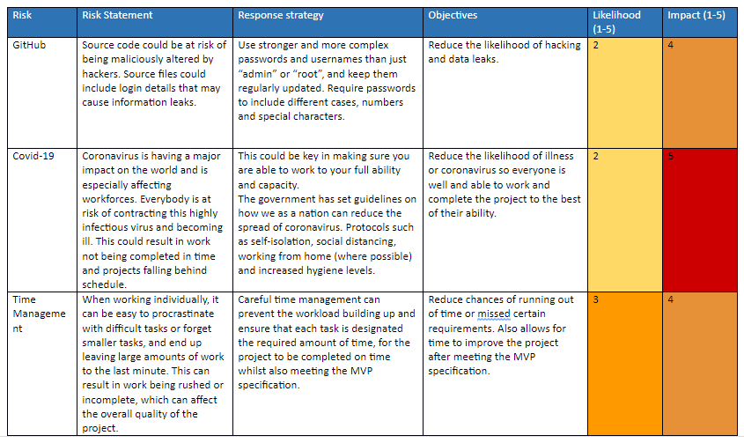

Slide 8
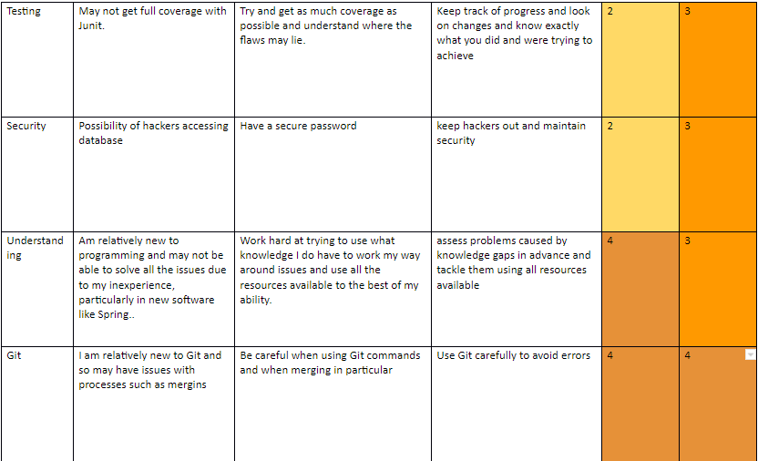

Slide 9
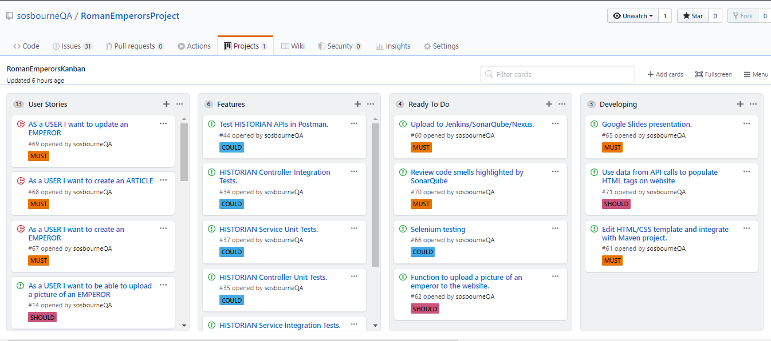
Kanban Board

Slide 10
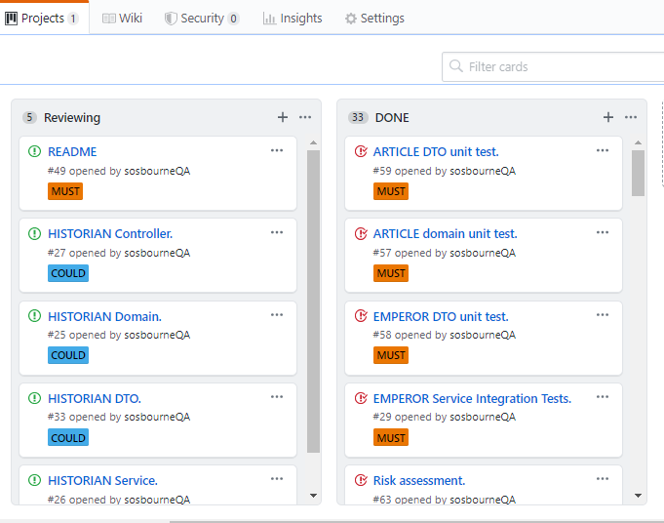

Slide 11
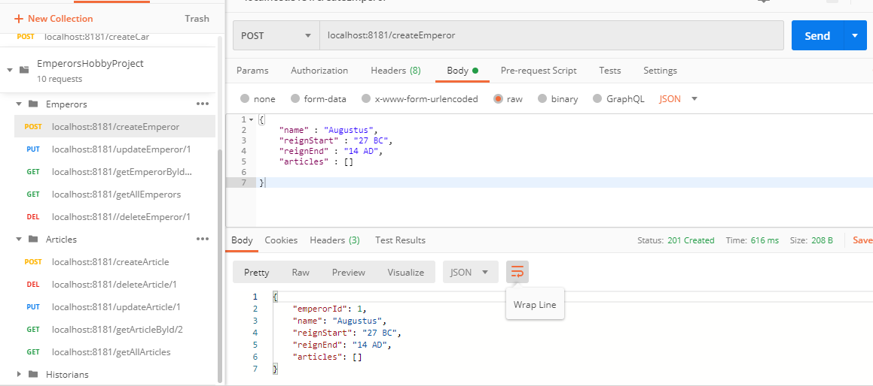
Postman

Slide 12
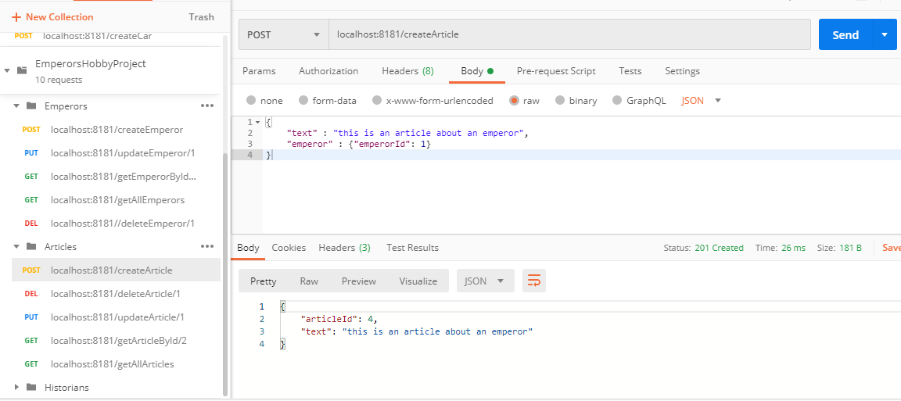

Slide 13
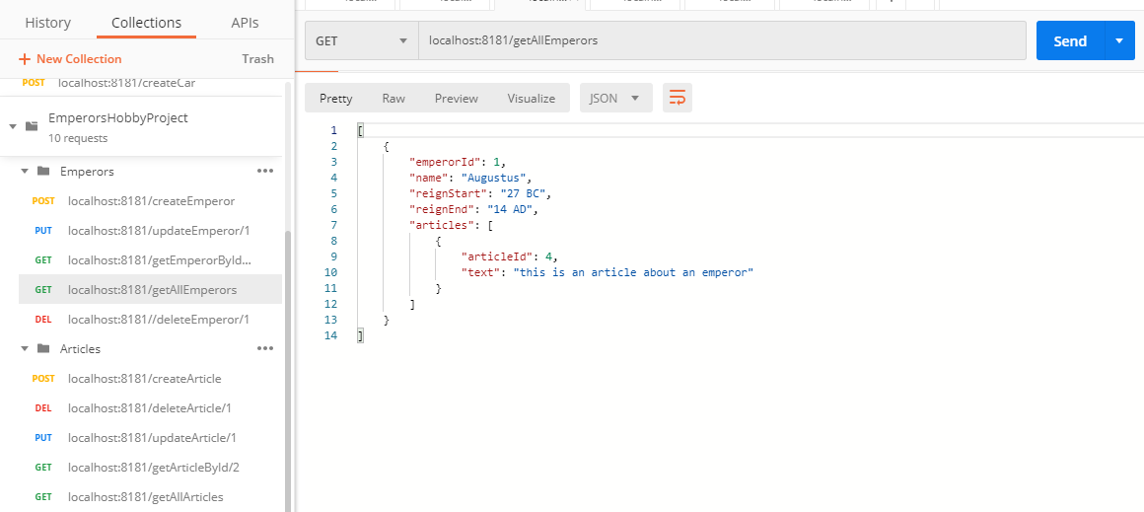

Slide 14
CI Pipeline
Jenkins
SonarQube
Nexus

Slide 15
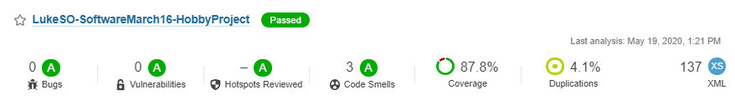
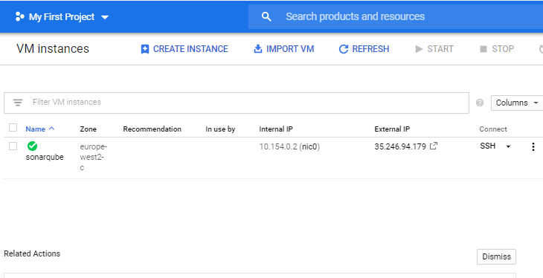
SonarQube
Hosted on a GCP VM instance
Powerful Static Analysis tool

Slide 16
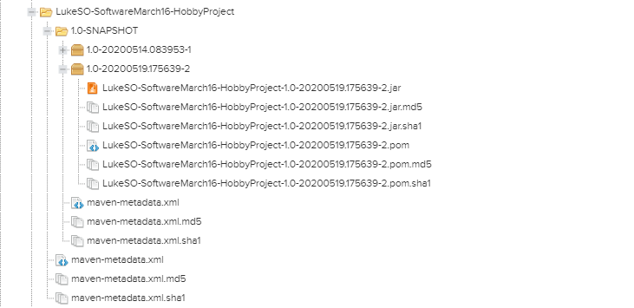
Nexus

Slide 17
Demo
Show code structure
View application in ‘localhost:8181’
Show database

Slide 18
Areas to Improve
Add extra functionality to make the application more suitable for public release - entities for User and Historian.
Improve test coverage - implement Selenium.
Develop front-end further - improve understanding of JavaScript in particular to increase the functionality of the web-application.
Make more use of GitHub features

Slide 19
Questions?

